Slide 1


Session 3
Prof. Peter Alexiadis & Prof. David Bailey K.C.

Slide 2
TABLE OF CONTENTS
I. AN OVERVIEW OF
COMPETITION POLICY
II. MULTILATERAL PRACTICES IV. GOVERNANCE & PROCEDURE
1. CARTEL PROCEDURE 1. PUBLIC vs PRIVATE ENFORCEMENT
HUB-AND-SPOKE CARTELS 2. BURDEN & STANDARD OF PROOF
BID-RIGGING SCENARIOS 3. ROLE OF PRESUMPTIONS
2. COOPERATION AGREEMENTS 4. COMPETITION VS. REGULATION
EXCHANGES OF INFORMATION 5.INSTITUTIONAL COOPERATION
STANDARDISATION BODIES
3. VERTICAL RESTRAINTS
III. UNILATERAL PRACTICES IV. STATE ENTITIES
MARKET DEFINITION 1. DISCIPLINING STATE ENTITIES
HIGH TECH ABUSES 2. REGULATING STATE SUBSIDIES
MARGIN SQUEEZES
SELF-PREFERENCING
3. REFUSALS TO DEAL
4. EXPLOITATIVE ABUSES

Slide 3
I. COMPETITION POLICY OVERVIEW (i)
WHY COMPETITION LAW?
There is a widespread belief in markets → de-monopolisation, deregulation, liberalisation, adoption of market-based economies
As a general proposition markets should police themselves
In a competitive market, no firm can determine output or price
In a competitive market, it is consumers who decide what they want, how much they want, when and for how much!
But firms may have market power and there is a risk of abuse of market power
Competition laws ensure that the free market is not abused and that the process of competition is not restricted or distorted

Slide 4
I. COMPETITION POLICY OVERVIEW (ii)
WHY COMPETITION LAW?
Competition law has grown at a phenomenal rate in recent years in response to profound changes in thinking and a growing appreciation of competition
Competition is “the keen, cutting edge of business” (Henry Ford)
Competition is “the mother of invention” (Horace Jackson Brown Jr)
Competition is “the incentive to progress” and “the basis of protection to the consumer” (Herbert Hoover)
There are now at least 130 systems of competition law in the world, in all continents and in all types of economies
Many economic activities that once were regarded as the preserve of the state have been opened up to competition

Slide 5
I. COMPETITION POLICY OVERVIEW (iii)
WHY COMPETITION LAW?
It is important to be clear what competition law is for
To protect competition?
To protect competitors?
To protect consumers?
To protect society?
To protect employees?
To keep markets open and contestable?
To achieve fairness in the marketplace?

Slide 6
I. COMPETITION POLICY OVERVIEW (iv)
LIMITS OF COMPETITION LAW
Competition law is not consumer protection law
Competition law is not sectoral regulation
Competition law is not an instrument of public policy, whether industrial policy, employment, environmental policy
It is desirable that the limits of competition law should be clearly understood, and that these other policies should be implemented as a result of other instruments available to governments

Slide 7
I. COMPETITION POLICY OVERVIEW (v)
WHAT PROBLEMS DOES COMPETITION LAW ADDRESS?
Anti-competitive agreements
Agreements between competitors to fix prices, share markets or restrict output
Agreements between a supplier and a customer to fix prices, restrict online sales
Abuse of substantial market power
Predatory pricing, price discrimination, excessive pricing
Exclusive dealing, fidelity rebates, tying and bundling
Refusals to deal, margin squeeze, preferential treatment

Slide 8
I. COMPETITION POLICY OVERVIEW (vi)
WHAT PROBLEMS DOES COMPETITION LAW ADDRESS?
Merger control
Harmful mergers and acquisitions are those that give to firms such strong market positions that allow them either to control conduct on today’s markets or to control the development of tomorrow’s ones
Mergers between competitors may directly remove competition and enable the merged firm to acquire or strengthen its market power
Mergers between companies at different but related stages of a supply chain may prevent competitors from accessing a market and foreclose competition
NB Market studies, market investigations, sectoral inquiries, competition advocacy

Slide 9
II. MULTILATERAL PRACTICES

Slide 10
1. CARTEL PROCEDURES (i)
How to craft an effective cartel enforcement regime
Why go after ‘hard-core’ cartels?
How do we detect such cartels?
What evidence do we need to prove the existence of such cartels?
What sanctions are necessary in order to deter cartels?
Is there a case for a settlement procedure for cartels?

Slide 11
1. CARTEL PROCEDURES (ii)
Atypical cartels: hub-and-spoke conspiracies
Supplier B
Retailer C
Retailer A

Slide 12
1. CARTEL PROCEDURES (iii)
Hub-and-spoke conspiracies
UK cases tell us that a concerted practice could exist where:
Retailer A discloses to supplier B its future pricing intentions
Retailer A may be taken to intend that B will make use of that information to influence market conditions by passing that information to other retailers (of whom C is, or may be, one)
Supplier B passes that information to Retailer C
Retailer C may be taken to know the circumstances in which the information was disclosed by A to B and
C uses the information in determining its own future pricing intentions
UK cases: JJB Sports v OFT (2004), Argos v OFT (2004), Tesco v OFT (2012)

Slide 13
1. CARTEL PROCEDURES (iv)
Bid-rigging scenarios
Surge in enforcement activity over past 20 years with respect to bid-rigging and related competition law infringements.
Importance of government-financed infrastructure projects and services contracts has raised the level of activity. Recessionary pressures, centralisation of budgets and consolidation of projects has created “winner takes all” environments in which consortium bids are prevalent and incentives for bid-rigging are exacerbated.
Uneasy distinction drawn in many cases between bidding consortia (assessed on the basis of its “effects” on the market and subject to exemptions) and classic bid-rigging behaviour (assessed as a clearly defined “by object” cartel offence).
Bidding consortia often satisfy exemption criteria because they bring together complementary services and are indispensable for large-scale projects.

Slide 14
1. CARTEL PROCEDURES (v)
Bid-rigging scenarios
Bid-rigging practices can take many forms, including contract allocations in multi-part contracts, selective refusals to bid, the filing of procedurally faulty bids, the filing of coordinated artificially high bids, geographic discrimination of bids, veiled sub-contracting or agency arrangements, etc.
Exemptible bidding consortia arrangements usually lower individual entry barriers and facilitate the participation of smaller, specialist market actors.
Relative importance of public procurement regime in place in screening many forms of illegal behaviour, including transparency and openness of bidding terms.

Slide 15
2. COOPERATION AGREEMENTS (i)
Common Analytical Characteristics
Does the cooperation being investigated affect adversely certain characteristics?
(O)utput
(P)rice
(Q)uality
(R)ange
(S)ervice
(T)echnology
Foreclos(U)re

Slide 16
2. COOPERATION AGREEMENTS (ii)
Exchanges of information
Business people talk about a lot of things in a variety of contexts: conferences, trade associations, industry initiatives, lobbying
Businesses also make public announcements about their products, plans, performance; earnings calls with analysts
But some businesses also discuss their current and future pricing intentions and commercial strategy

Slide 17
2. COOPERATION AGREEMENTS (iii)
Exchanges of information
Competition law is principally concerned with exchange between competitors of commercially sensitive information
Commercially sensitive information is typically confidential and likely to influence the commercial strategy of competitors – things you don’t want your competitors to know!
Information about the general state of an industry or relating to non-confidential technical issues, such as standards or health and safety matters are not commercially sensitive

Slide 18
2. COOPERATION AGREEMENTS (iii)
Exchanges of information: The EU T-Mobile Case
5 mobile phone operators in the Netherlands held a single meeting - called for a legitimate purpose – at which they exchanged confidential information about the remuneration they would pay to their dealers
A guiding principle is that firms determine their strategy and conduct independently
Competition law prohibits a concerted practice that involves knowingly substituting practical cooperation for competition
A concerted practice can be established on the basis of just one meeting!

Slide 19
2. COOPERATION AGREEMENTS (iv)
Standards-setting
Generally viewed positively because of its potential to lower output and sales costs while enhancing product safety and interoperability capabilities
Viewed negatively (a “by object” offence) when it is part of a broader scheme to exclude potential competition
A range of markets can be affected, including:
different products;
innovation; and
standardisation.

Slide 20
2. COOPERATION AGREEMENTS (v)
Standards-setting
An anti-competitive “effects” analysis requires a review of:
the legal and economic context;
the extent to which markets are affected;
the extent to which access to standards is open and non-obligatory; and
the extent to which excluded parties can benefit from cooperation on standards.
IP rights are often a critical element of the standardisation process, including good faith disclosures, FRAND commitments and the use of independent valuations
Efficiencies in the standards process can be established where the restrictions are indispensable and results are open to competitors

Slide 21
3. VERTICAL RESTRAINTS
The desire to promote competition in the vertical supply chain reflects the policy desire to promote intra-brand competition, in addition to traditional concerns about inter-brand competition, especially where suppliers with market power create exclusive distribution arrangements with wholesalers or retailers
Resale Price Maintenance (RPM) obligations are treated as “by object” competition law offences, subject to very limited exceptions, while truly recommended prices are not seen as problematic
Territorial restrictions and restrictions on addressable customers are not universally condemned across the world, but play an important role in the EU as part of the market integration goal

Slide 22
III. UNILATERAL PRACTICES

Slide 23
III. UNILATERAL PRACTICES (i)
MARKET DEFINITION & MARKET POWER
The first analytical step in the assessment of an abusive commercial practice is the identification of the relevant product and geographic markets affected by the practice, as a prelude to determining whether an entity holds market power (or “dominance”) in that market
The traditional basis for defining a relevant product market is the concept of “substitutability”, usually seen from a customer demand perspective. In certain cases, the ability of producers to shift production quickly to alternative products can also determine the scope of a product market (“supply side” substitution)
Where feasible, Competition Authorities deploy the “Hypothetical Monopolist Test” to define a relevant product market. In a digital world, that test needs to be modified to take into account the quality dimension where the monetary value of goods is not evident
The geographic dimension of a relevant market is determined by whether the “underlying conditions of competition are sufficiently homogeneous”, which can be influenced by a range of factors in any given case, including: licensing; customer location; trade barriers.
It is always wise to define markets by relevance to different criteria and to compare the results

Slide 24
III. UNILATERAL PRACTICES (ii)
MARKET DEFINITION & MARKET POWER
Many of the more complex issues affecting market definition focus on high tech industries, including:
the impact of bundling practices;
the role of “aftermarkets”;
the treatment of multi-sided platforms;
the relevance of the concept of “digital ecosystems”;
the impact of product differentiation and price discrimination; and
the importance of R&D in any given sector.
The second analytical step before proceeding to assess whether a commercial practice is abusive is to determine market power
The existence of market power should always involve a comprehensive analysis of all relevant economic factors, but will always attach great significance to very high market shares

Slide 25
III. UNILATERAL PRACTICES (iii)
2. POTENTIAL DIGITAL SECTOR ABUSES
Which entities are we talking about?
Why are digital platforms susceptible to abuses of market power?
Direct and indirect ‘network effects’
Incumbency advantage in terms of data, scale, name recognition
Users tend to ‘single-home’
High barriers to entry, expansion and exit
What are the main competition concerns?

Slide 26
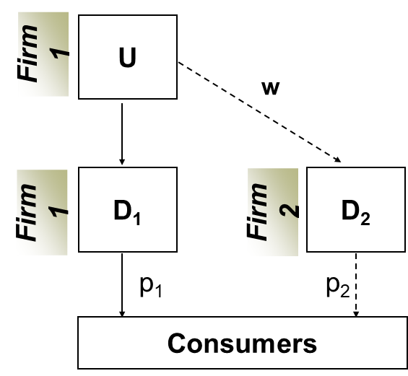
III. UNILATERAL PRACTICES (iv)
Margin Squeezes
A vertically integrated firm holding a
dominant position in the upstream
market (firm 1) prevents its downstream
competitor (firm 2) from achieving an
economically viable price-cost margin

Slide 27
III. UNILATERAL PRACTICES (v)
Margin Squeezes
Firm 1 could refuse to supply product U to firm 2
Firm 1 could charge an excessive price for product U to firm 2
Firm 1 could charge a predatory price for product D1
But Firm 1 could also engage in a margin squeeze
It may charge a price for product U on the upstream market which compared to the price it charges for product D1 on the downstream market does not allow an equally efficient competitor to trade profitably in the downstream market on a lasting basis

Slide 28
III. UNILATERAL PRACTICES (vi)
Self-preferencing: the EU Google Shopping case
Google used its dominance in one market (general search) to get an unjustified advantage in a neighbouring market (comparison shopping services), instead of competing on the merits
Google promoted its own “comparison shopping” service in its general search results, to the detriment of rivals by:
Systematically positioning Google Shopping at the top of search results
Demoting rival comparison shopping services in search results
Google Shopping gained significant traffic at the expense of its rivals

Slide 29
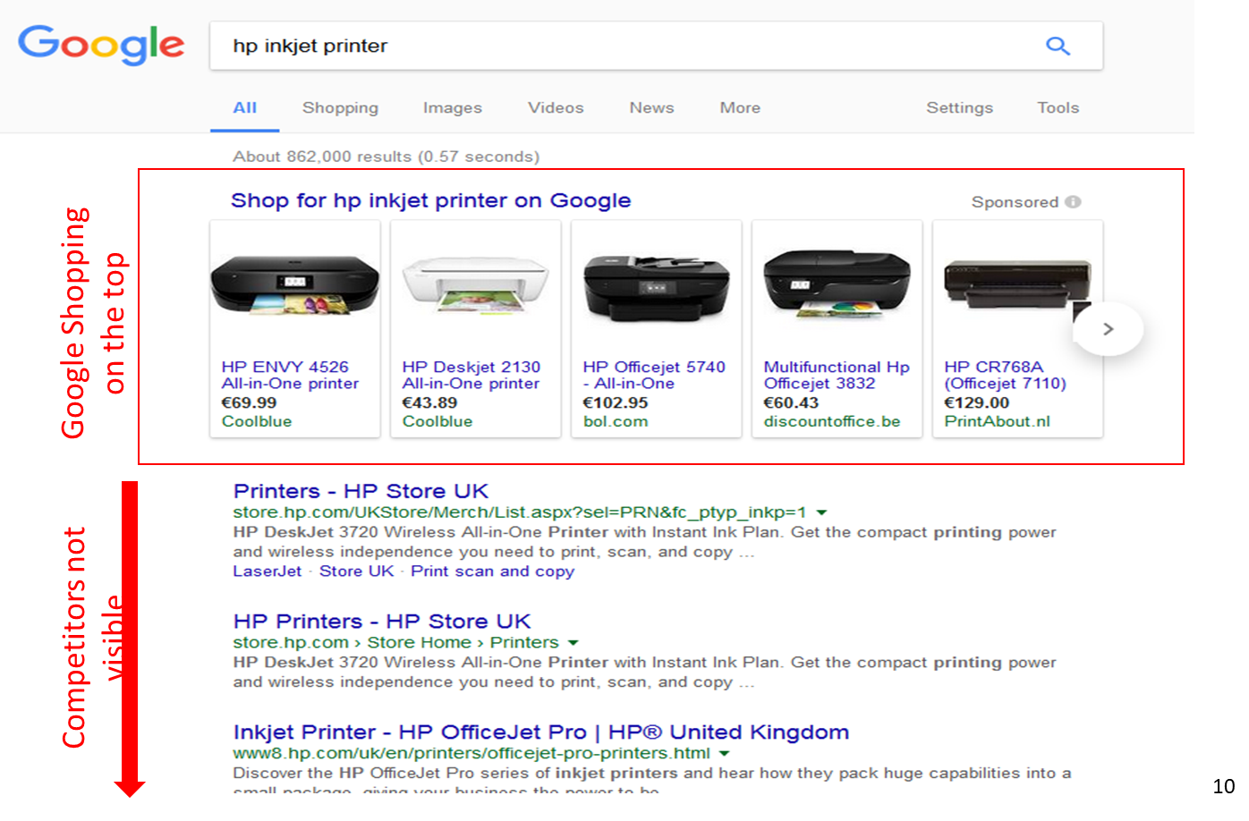
III. UNILATERAL PRACTICES (vii)

Slide 30
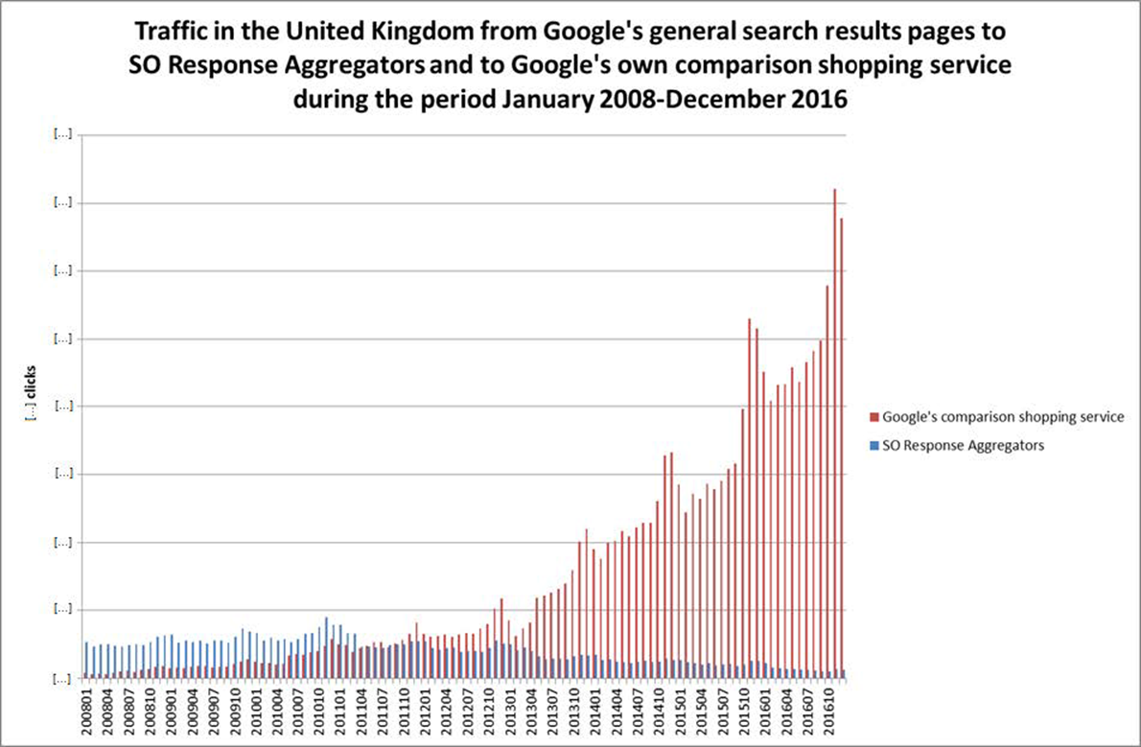
III. UNILATERAL PRACTICES (viii)

Slide 31
III. UNILATERAL PRACTICES (ix)
Self-preferencing: Google Shopping remedy
Cease and desist order: Google must ensure equal treatment between Google Shopping and rival comparison shopping services
It was for Google to choose how to comply as long as it abides by the core principle of equal treatment
In 2017 Google introduced an arms-length auction by which rival comparison shopping services and Google Shopping bid for ads to appear on Google’s search results pages (an access remedy)
The effectiveness of the remedy has been controversial!

Slide 32
III. UNILATERAL PRACTICES (x)
3. Refusals to Deal
A significant difference in approach between situations where the owner or operator decides to deny access to downstream competitors of a facility designed for its own use and that which is designed or is anticipated to be used by competitors
De novo refusal to deal is usually addressed by the “essential facilities” test established in the Oscar Bronner and Volvo Cases, which requires that three conditions be satisfied:
the access product is “indispensable” for business;
there is no objective justification for the access refusal;
the refusal eliminates all competition in the secondary market; and
in the case of IP rights, the refusal prevents the growth of a “new product” for which there is demand

Slide 33
III. UNILATERAL PRACTICES (xi)
3. Refusals to Deal
Over time, the essential facilities doctrine has been restricted where certain circumstances arise, especially as regards the ‘indispensability’ notion:
where sectoral regulation already prescribes access (TeliaSonera)
if the facility owner has benefited from State subsidies (Slovak Telekom)
if the need for interoperability is inherent to the product (Android Auto)
where the offence can be characterised on an alternative basis (Lithuanian Railways, many margin squeeze cases, self-preferencing under Google Shopping)
Where ongoing commercial relations exist, refusals to deal are often addressed by reference to the “dependency” doctrine that are commonly found in European Member State competition laws

Slide 34
III. UNILATERAL PRACTICES (xii)
4. Exploitative Abuses
Concerned with the control of conduct that ‘unfairly’ exploits market power to the detriment of others
Examples: excessive pricing, unfair business terms, discrimination, inefficiency
Historically, enforcement practice has been very limited: why?
Renewed interest within the EU: Aspen (2021), Apple/Spotify (2024), Meta Marketplace (2025); and in the UK: Phenytoin (2022)
Ongoing investigations into Google’s use of AI content and into WhatsApp’s prohibition of third-party AI providers

Slide 35
III. UNILATERAL PRACTICES (xiii)
4. Exploitative abuses: excessive pricing
The basic test is whether the price is unfair
EU and UK cases ask whether the dominant firm has reaped trading benefits which it could not have obtained in conditions of "normal and sufficiently effective competition“
There is no single method or way in which an unfair pricing abuse might be established
Depending on the facts of the case, a competition authority or claimant might use one or more alternative methods

Slide 36
III. UNILATERAL PRACTICES (xiv)
4. Exploitative Abuses: Excessive Pricing
One of the most well-known and well-established test for excessive pricing is derived from the United Brands Case, under which it must be established that:
Price is excessive in relation to costs of production plus its cost of capital and
Price is unfair either in itself or by comparison with comparable products
Competition Authorities have a margin of manoeuvre or appreciation in deciding which methodology to use and which evidence to rely upon

Slide 37
III. UNILATERAL PRACTICES (xv)
4. Exploitative Abuses: Unfair Pricing
The concept of prices that are “unfair in themselves”:
Consider Kent v Apple (2025), where Apple’s fees on purchases of apps and in-app purchases were unfair in themselves as it is an unconstrained monopolist
Consider also Attheraces v British Horseracing Board (2007), where the Court of Appeal contrasted two situations:
A monopoly supplier of a delicacy to a supermarket charges a price equal to the full value that the supermarket would charge to its consumers: this is unobjectionable
A monopoly electricity supplier charges customers the full price that they would be willing to pay: this is, in all likelihood, objectionable

Slide 38
III. UNILATERAL PRACTICES (xvi)
4. Exploitative Abuses: Unfair Pricing
Excessive prices may be unfair by comparison:
A non-monopolised market: Bodson
A separate segment of the same market: Napp; Hydrocortisone
A separate but closely related product market: Phenytoin
Another Member State: Ministère Public v Tourneau; AKKA/LAA
Another country outside the EU: MicroLeader (EEA v Canada)
How do you identify a valid comparator?

Slide 39
IV. GOVERNANCE & PROCEDURE (i)
1. Public & Private Enforcement
Both regimes need each other
Private actions can rely on decisions by competition authorities
Public bodies cannot investigate everything and can rely on private actions
They interact with one another
Private litigants often want access to the evidence gathered by competition authorities
Competition authorities want to facilitate private enforcement without endangering firms’ willingness to come forward and cooperate: leniency!

Slide 40
IV. GOVERNANCE & PROCEDURE (ii)
1. Public & Private Enforcement
Need to consider:
Whether to make decisions binding on courts and parties in private actions
Whether to protect leniency statements from disclosure in private actions
Whether to protect settlement submissions from disclosure
Whether to allow private litigants access to the authority’s case file
Whether a competition authority should be permitted to intervene in private cases
Whether a competition authority should be able to require redress

Slide 41
IV. GOVERNANCE & PROCEDURE (iii)
2. Burden and Standard of Proof
The legal burden of proving the infringement is on the person alleging the infringement of competition law
The legal burden of defending an anti-competitive agreement or conduct on efficiency grounds is on the party to the agreement or engaging in the conduct
The evidential burden of demonstrating that an event happened is on the person advancing the assertion: he or she who asserts must prove

Slide 42
IV. GOVERNANCE & PROCEDURE (iv)
3. Role of Presumptions
There are lots of presumptions in competition law!
Presumption of innocence
Presumption of dominance from market shares > 50%
Presumption that sales below average variable/avoidable costs are abusive
Presumption that a firm participated in a cartel if it attended a cartel meeting
Presumption that a firm that owns 100% of the issued share capital or voting rights in another firm controls the latter
Presumptions of this kind reflect inferences that can normally be drawn from the evidence

Slide 43
IV. GOVERNANCE & PROCEDURE (v)
3. Role of Presumptions
Presumptions are used for the purposes of jurisdiction, procedure, evidence, substance or enforcement
Presumptions are normally rebuttable by adducing evidence
Presumptions do not normally reverse the legal burden of proof
See the OECD roundtables on legal presumptions and safe harbours in 2017 and structural presumptions in 2024

Slide 44
IV. GOVERNANCE & PROCEDURE (vi)
4. Competition vs. Regulation
Currently the ascendancy of one legal regime over another or the manner in which they relate to one another, is the subject of some controversy
Generally understood that competition policy (ex post) addresses fact-specific anti-competitive acts, while sector-specific regulation (ex ante) addresses various forms of “market failure” generated by market structure or the dynamics of certain sectors
Important to develop clear lines of demarcation between the reach of the two disciplines or establish clear means by which they can contribute to one another’s more effective application (important to avoid “double jeopardy”)
The concentration of cross-sectoral regulatory powers, or regulatory and competition powers together, has its supporters and detractors, but there is no “one size fits all” solution for every jurisdiction

Slide 45
IV. GOVERNANCE & PROCEDURE (vii)
5. Institutional Cooperation
Critical to have effective cooperation and consultation mechanisms in place between sectoral regulators and the National Competition Authority. Participation on regional and international bodies is essential in maintaining the right balance between keeping up to date with modern enforcement techniques, avoiding enforcement overlaps and sharing costs for investigations into certain sectors to develop benchmarking techniques and identify “best practices”
Cross-fertilisation of knowledge is critical to improve capabilities of respective institutions and to cut costs in terms of avoiding the unnecessary duplication of tasks
Maintaining an adequate budget to be able to take advantage of enforcement networks and fostering continuing education is critical to maintaining independence and effectiveness
Capacity building is essential to ensure that the Competition Authority is well resourced and is capable of attracting the right level of expertise. This effort also requires the appropriate IT and AI tools to facilitate detection and to monitor compliance
There should be clear lines of demarcation between independence in decision-making on competition law grounds and the pursuit of broader non-competition goals consistent with transparent government policy

Slide 46
V. STATE ENTITIES (i)
1. Disciplining State Entities
Unique European provision subjecting State-controlled companies or those upon whom “special or exclusive rights” have been conferred to respect competition rules (Article 106 TFEU)
Actions of such entities lie outside the scope of competition rules where they are responsible for performing clearly defined Services of General Economic Interest for the benefit of the general public
The intervention can be quicker and more comprehensive than actions taken against private firms under general competition rules

Slide 47
V. STATE ENTITIES (ii)
2. Regulating State Subsidies
Within the European Union, a unique system applies which prohibits markets being distorted by any form of State subsidy (“State Aid”) which satisfies the following characteristics:
its grant is imputable to the State and is funded through State resources;
it confers a selective economic advantage to one or more economic entities;
the measure is distortive of competition;
It potentially affects trade between Member States.
Non-EU entities investing in the EU (either through mergers or public bids) are subject to scrutiny where they benefit from Foreign Subsidies or subject to Foreign Direct Investment rules where they seek to invest in strategic industries.

